Slide 1
THE FOUNDRY
Report on Communications and Outreach
to the Foundry Advisory Committee
July 7, 2019
Lemelson-MIT Program and Lesley University
on Behalf of the Foundry Consortium

Slide 2
Immediate & Ongoing Priorities
2018-2019
Outreach & Engagement:
  Community groups & nonprofits
  Members of the community
  Business community
  Learning by example from other centers and organizations
Design considerations shaped by community needs/wants:
  Flexible Performance Space
  Makerspace
  Art space
  Classrooms & Community space
  Office space
Validation of the fiscal model
Formation of the non-profit entity by November 1, 2019
Fundraising for pre-operations
Development of criteria for prioritizing use of the space and the curation of programming in accordance with the needs of Cambridge residents
Notes:
Steph
When our proposal was accepted, we – along with the CRA, City, and designers – started planning and prioritizing.
First priority is both immediate and ongoing: outreach and engagement with individuals and organizations. We don’t want to reinvent the wheel, given the deep conversations that have already happened; but we want to learn from all of you about what you think is important, and about ideas we may not have heard about.
Design process dictates other priorities, starting with the more complicated and technical designs.
As the design progresses and we know more about what the Foundry space will look like, we’ll be able revisit the fiscal model to ensure the Foundry will be self-sustaining.
We will create a new nonprofit entity that will be the Foundry Operator, by early 2019.
As we bring together all the information from community engagement, site visits, and know what the final design will be, we will be able to begin curating the programming.

Slide 3
Outreach and Engagement
Three makerspace meetings
Several performance/visual arts meetings to discuss physical design and programming
March 2019: Foundry Coffee Chat to provide neighborhood residents with an update and to solicit feedback on programming
Since April, 2018, a total of 213 individual meetings and 63 group meetings!
Online survey fielded over four-months (February 21, 2019 – June 30, 2019) yielded responses from 89 participants.
Zip codes reported:
02138
02139
02140
02141
02142
02143
02145
02155
02771
Notes:
Steph

Slide 4
Top Ranked Pre-Set Choices for
Foundry Experiences (in rank order)
Cook or take a yoga class
Meet a friend at the café
Watch a play
Rent space for an event
Experience an exhibition
Tinker in the maker space
Learn or share a new job skill
Other STEAM related programs
Create and display your own artwork
Read a book
Teach an art or maker class
Dance or sing in a performance
Enroll your child in an afterschool program
Team up on a theater production
Explore set design
Invent a new product
Rehearse a performance
Sew a costume
Notes:
Katherine

Slide 5
Desired Experiences: Categories of Open-Ended Responses from Residents
Cooking and food
Health & well-being
Enjoying theater
Enjoying or displaying art
Tinkering in the maker Space
Pursuing hobbies
Gaining job skills and employment
Engaging with technology
Other educational pursuits
Reading books
Enjoying dance
Enjoying music
Enjoying films
Children, families & leisure space
Ensuring accessibility
Civic, community and cultural engagement (highly cited category)
General operations
General space
Notes:
Katherine

Slide 6
Factors That Would Impact Use of Foundry
Culture and climate
No parking
Mix of space uses
Time, a job and busy schedule
Financial issues
Operations
Hours of operation
Public transportation
Parent responsibilities
Distance from home
Safety
Health issues
Accessibility
Bad weather
Nothing
Maintenance
Traffic
Sustainability
Demographics
Lack of information
Beverages
Notes:
Katherine

Slide 7
Alignment Between Goal in the Foundry Consortium Proposal & Residents’ Desires
Forge new and sustained connections between individuals, families, community organizations and business leaders through shared use of space (accessible to all) and programming that fosters creativity, invention, innovation and the acquisition of workplace competencies
A New Form of Civic Engagement – Fostered by a Space Like No Other That We Know Of As of This Date
Notes:
Stephanie

Slide 8
Ongoing Community Engagement
Continue building a coalition of the willing
Many ways to help:
- Sharing what is learned through conversations
Ex: Artists’ needs for space, e-commerce and market
expansion
- Fundraising events for pre-operations
- Partnering on grant proposals to seed co-located
programming (at home site and at the Foundry)
- Helping us locate people to rent space
(starting in 2020)
Notes:
Stephanie

Slide 9
Candy Chang participatory public artist exploring processes of civic engagement
Strauch-Mosse Visiting Artist Lecturer
Community Breakfast
Friday, October 25
8:00 – 11:00 a.m.

Slide 10
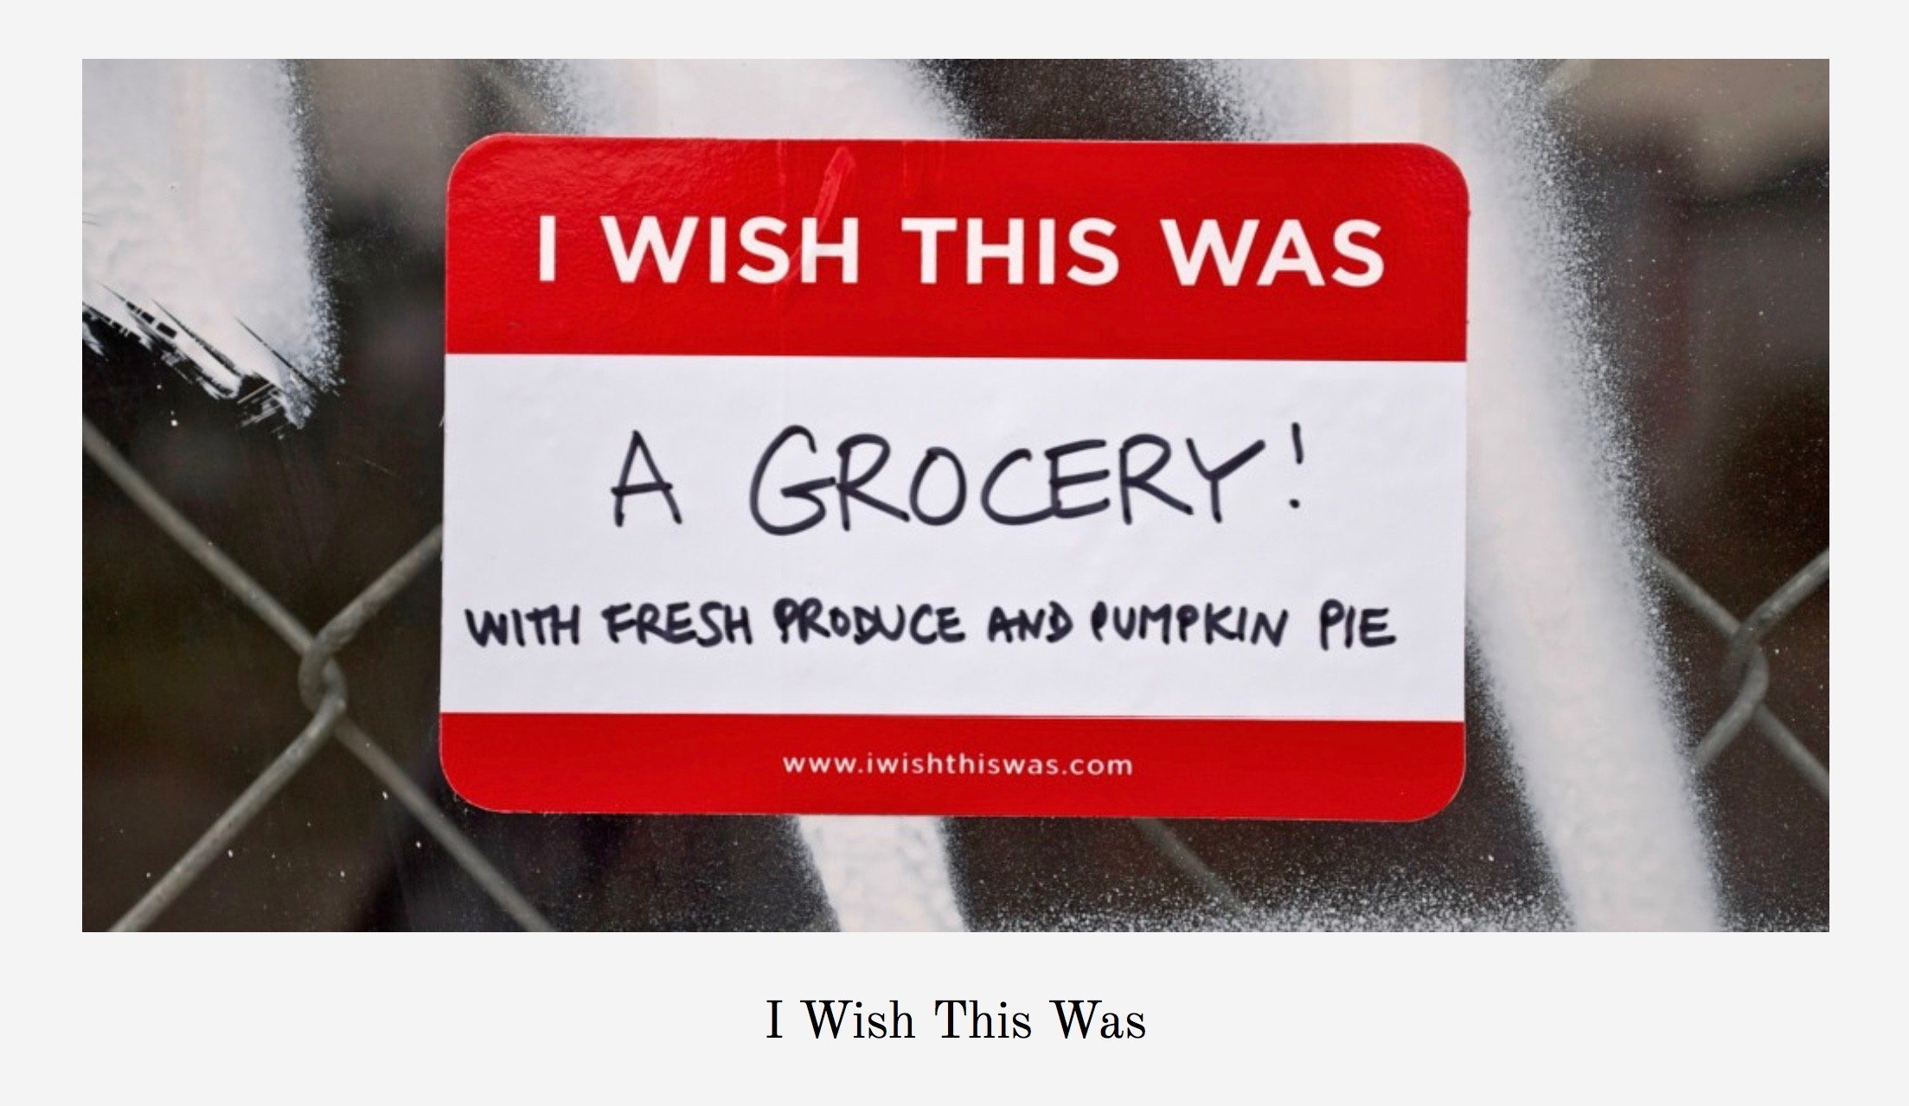

Slide 11
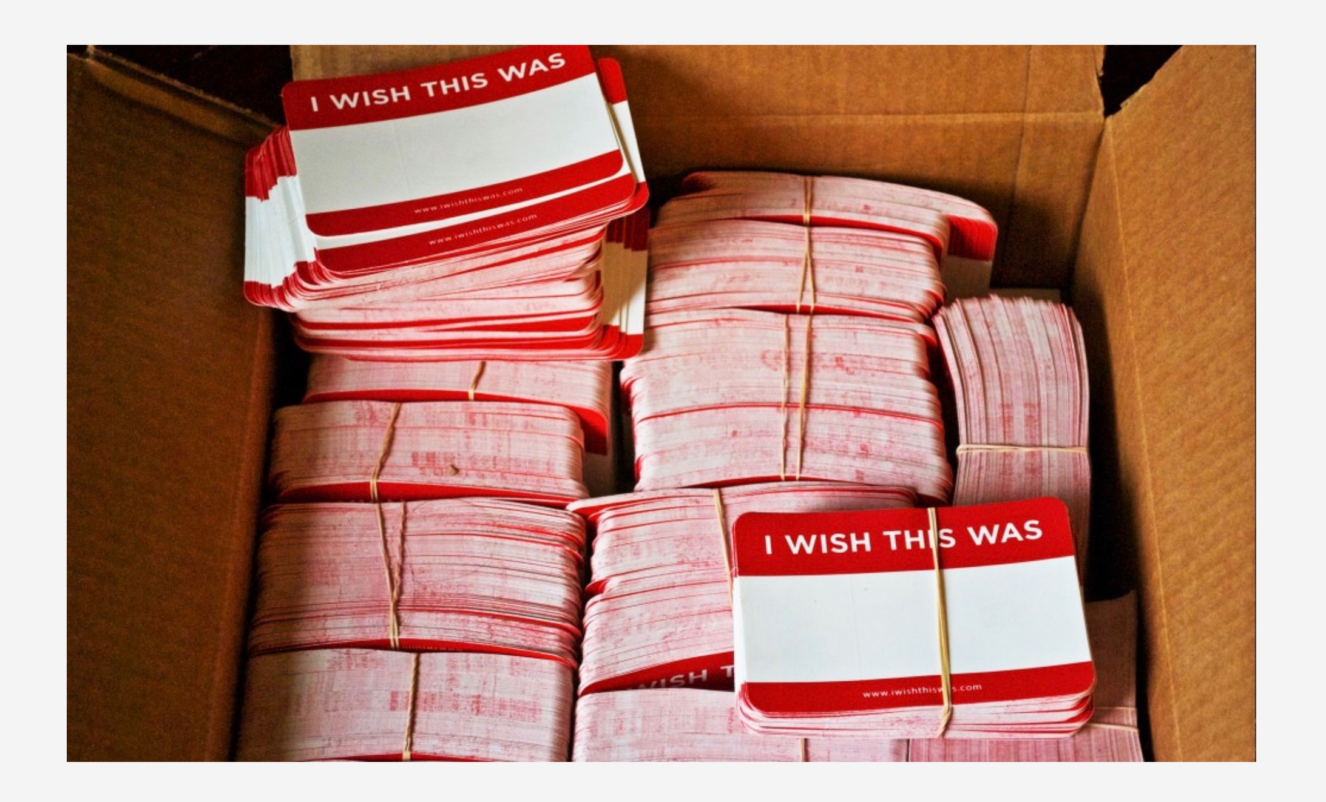

Slide 12
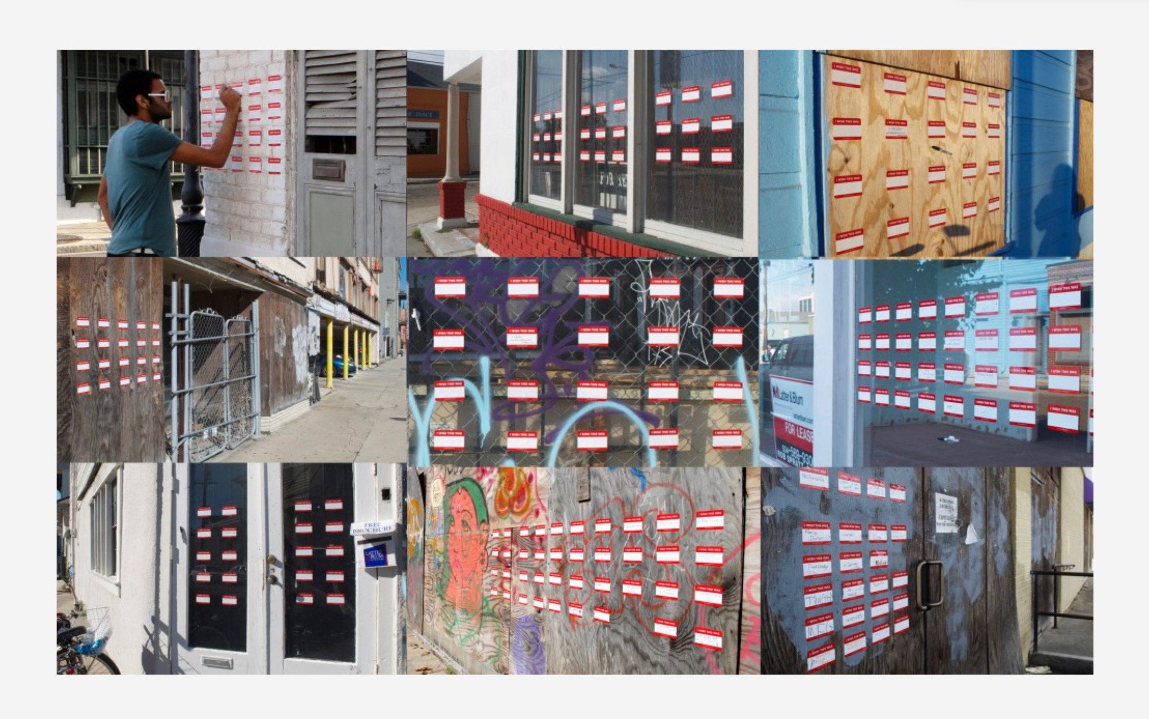

Slide 13
